Slide 1






Web Fundamentals (HTML5 and CSS3)
Course Overview
HTML & CSS
SoftUni Team
Technical Trainers
Software University
http://softuni.bg

Slide 2







Table of Contents

Slide 3
Have a Question?
sli.do #front-end

Slide 4






SoftUni Diamond Partners

Slide 5






SoftUni Diamond Partners

Slide 6

Front-End Development @ SoftUni
3 Months Web Front-End Training

Slide 7
Front-End Development: Module Goals
3 months intensive front-end
3 times weekly, lots of live coding and exercises
Part I – Web Fundamentals (HTML5 + CSS3)
HTML, document structure, CSS, selectors, rules, presentation and positioning, landing pages, forms, responsive design, transitions, animations, practical exam
Part II – JavaScript for Front-End
Bootstrap, CSS Preprocessors, Arrays, Objects, Maps, Sets, JSON, JQuery, DOM, Events, Ajax, Requests, HTTP, practical exam

Slide 8
Front-End Development Module – Timeline
21-May-2018
2-July-2018
12-August-2018
Web Fundamentals (HTML & CSS)
Lessons + exercises + exam
6 weeks * 3 times / week
6 credits
Start: 21-May-2018
Final exam: 1-July-2018
JavaScript for Front-End
Lessons + exercises + exam
5 weeks * 3 times / week
6 credits
Start: 2-July-2018
Final Exam: 12-August-2018
Front-End Development Retake Exams

Slide 9

Web Fundamentals (HTML5 + CSS3)
Course Objectives & Program

Slide 10


Web Fundamentals – Course Topics
HTML and CSS Overview – HTML basic tags & CSS basic selectors
HTML Structure – Structural tags, Semantic tags & others
Introduction to CSS – Basic CSS styling, Rules, Selectors, Declaration
CSS in Depth – Types, Values, Ranges
CSS Formatting and Positioning - Styling text borders, Backgrounds, Size, Margins, Positioning etc.

Slide 11

Web Fundamentals – Course Topics (2)
Creating Landing Pages
HTML Forms and Styling – HTML controls, HTML forms
Responsive Design – Media queries, Flex-box, Flexible images, fonts, tables, menus etc.
Transitions, Animations & CSS 4 Grids – HTML5 transitions, HTML5 animations, CSS 4 Grids
Exam Preparations
Practical Exam

Slide 12

The Trainers Team

Slide 13

Trainers Team
Antonia Atanasova
Experience in HTML5, CSS3, JS, Bootstrap, C#, CMS Systems
Studies Web Development @ SoftUni
Studies Business Informatics @ UNWE
Technical Trainer in Software University
Digital Marketing Freelancer

Slide 14

Trainers Team
Yuliyan Ivanov
Experience in HTML5, CSS3, JS, C#, Bootstrap, MongoDB
Student with excellent grades at Software University
Experience : Personal projects with JavaScript, Owned a virtual items trading website

Slide 15

Web Fundamentals: More Details
Duration, Languages, Technologies

Slide 16

Training Duration – Web Fundamentals
Lessons: ~ 60 hours (onsite + YouTube videos)
Practical exercises (in class): ~ 70 hours
Homework: ~ 40 hours
Exam preparation: 8 hours
Exam: 6 hours
Schedule: 21 May – 1 July 2018
Exam date: 1 July 2018

Slide 17

Why HTML & CSS?
HTML & CSS – standard for Web UI
Web-based applications are very popular
Runs on any device with a web browser
HTML5 is currently the #1 job trend based on the fastest growing keywords found in online job postings
HTML5 takes bigger chunk of the mobile application market
Every IT professional should know HTML & CSS

Slide 18


Why English?
Why the slides are in English?
English is the native language of the software engineers
Specific terminology should be in English
Translations are inaccurate and funny
Just learn English!
No excuses

Slide 19



Learn to Search in Internet & Find Solutions
The course assignments require to search in Internet
This is an important part of the learning process
Some exercises intentionally have no hints
Learn to find solutions!
Software development includes everyday searching and learning
No excuses, just learn to study!
Developers learn new technologies, tools, languages every day!

Slide 20

Evaluation

Slide 21


Scoring System for the Course
Mandatory:
Final exam – 90%
Homework submissions – 10%
Bonuses:
Presence in class – 5% bonus
Forum activity – bonus up to 5%

Slide 22
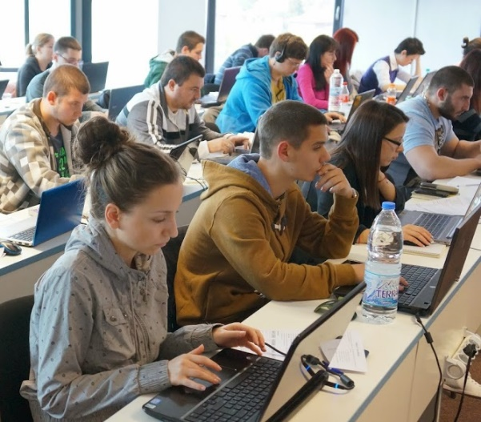

Web Fundamentals Exam
Practical HTML & CSS exam
4 practical problems for 6 hours
Slice a screenshot to HTML + CSS
Implement an HTML form (from screenshot to HTML + CSS)
Create a simple web page from screenshot (header + menu + sidebar + footer)
Make a website responsive

Slide 23
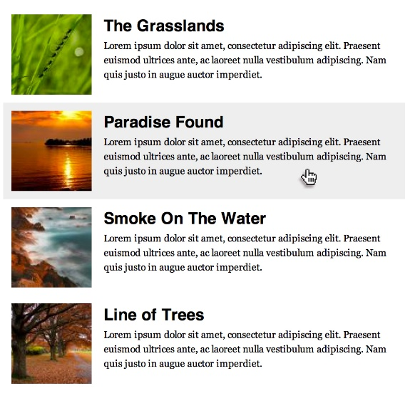


Sample Exam Problem
You are given a screenshot + set of images + texts
You should create the HTML & CSS to implement the page at the screenshot
+

Slide 24

Homework Assignments
Doing your homework is very important!
HTML and CSS can only be learned through a lot of practice!
You should write code every day!
Each lesson is followed by a few exercises
Try to solve them in class
The rest are your homework
Homework assignments are due in 6 days after each lesson
Submission are accepted through: judge.softuni.bg

Slide 25







Resources
What We Need Additionally?

Slide 26



Web Fundamentals Course: Website, Forum and FB Group
Official website:
Official discussion forum:
Official Facebook group:
https://softuni.bg/courses/web-fundamentals
https://softuni.bg/forum/categories/68/web-basics
https://www.facebook.com/groups/SoftUniWebFundamentalsHTML5May2018/

Slide 27

The Front-End Development Slides and Videos
All lecture slides, videos, homework assignments, projects and other resources are open content, available for free
Visit the course website to access the course resources

Slide 28

HTML & CSS Tutorials
W3School HTML Tutorial
http://www.w3schools.com/html/
Learn to Code HTML & CSS
http://learn.shayhowe.com/html-css/
CSS Tricks
http://css-tricks.com
Codecademy HTML & CSS Interactive Tutorials
https://www.codecademy.com/learn/learn-html-css

Slide 29

Software University Learning System (SULS)
Software University Learning System (SULS)
www.softuni.bg
Important resource for students
Homework submissions
Homework check-up
Exams and results
Reports about your progress

Slide 30








Recommended Software
You will need a good text editor, e.g.
Notepad++
You may try many HTML authoring tools like:
WebStorm
Visual Studio Code
Sublime Text / Atom / Brackets
Microsoft Visual Studio
Netbeans

Slide 31

Summary
The "Web Fundamentals" course teaches
The first steps in HTML & CSS
Training curriculum
HTML, tags, tables, forms, semantic HTML, CSS, styles, positioning, layout, responsive
Practical exam
4 practical problems for 6 hours
Learning resources
Slides, videos, software, books, forum

Slide 32







Web Fundamentals – Course Introduction
https://softuni.bg/courses/web-fundamentals-html5

Slide 33
License
This course (slides, examples, demos, videos, homework, etc.) is licensed under the "Creative Commons Attribution-NonCommercial-ShareAlike 4.0 International" license

Slide 34





Trainings @ Software University (SoftUni)
Software University – High-Quality Education, Profession and Job for Software Developers
softuni.bg
Software University Foundation
http://softuni.foundation/
Software University @ Facebook
facebook.com/SoftwareUniversity
Software University Forums
forum.softuni.bg

